Slide 1
NEWS VERP DESIGN STUDY + FILTER EXPLORATION
Katie Elfering
December 2018

Slide 2
Research Methodology
20 people were recruited to participate in a remote, unmoderated study on UserTesting.
½ of the participants were Bing users and ½ of the participants were Google users.
Participants reviewed the current Bing News experience and then compared that to designs that were shown using a prototype.
Participants gave feedback on the overall design as well as 4 specific filter design options.

Slide 3
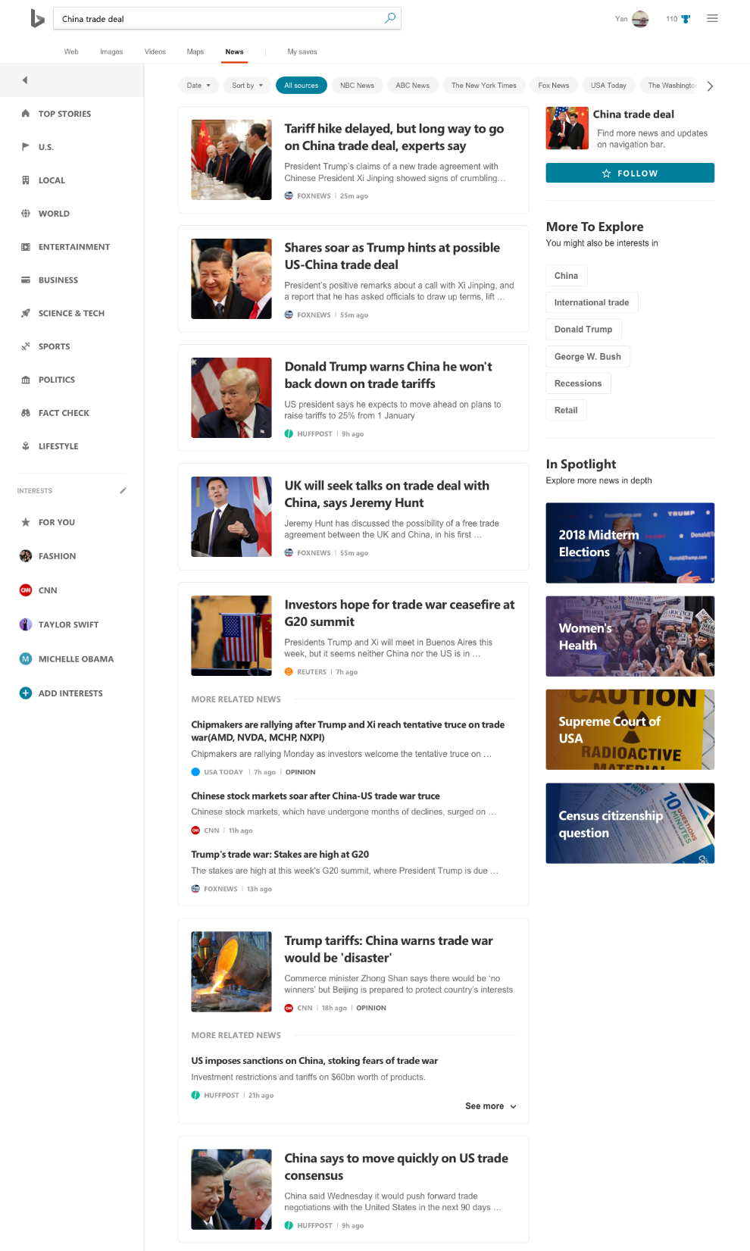
Key Findings
People overwhelmingly prefer the new News VERP design, both for the look/design and the organization.
People preferred the category navigation on the left side, as it was easier to use and helped the filters stand out more easily.
People found it easier to see the features in the right rail and to understand what they did, although some still questioned how necessary they were.

Slide 4
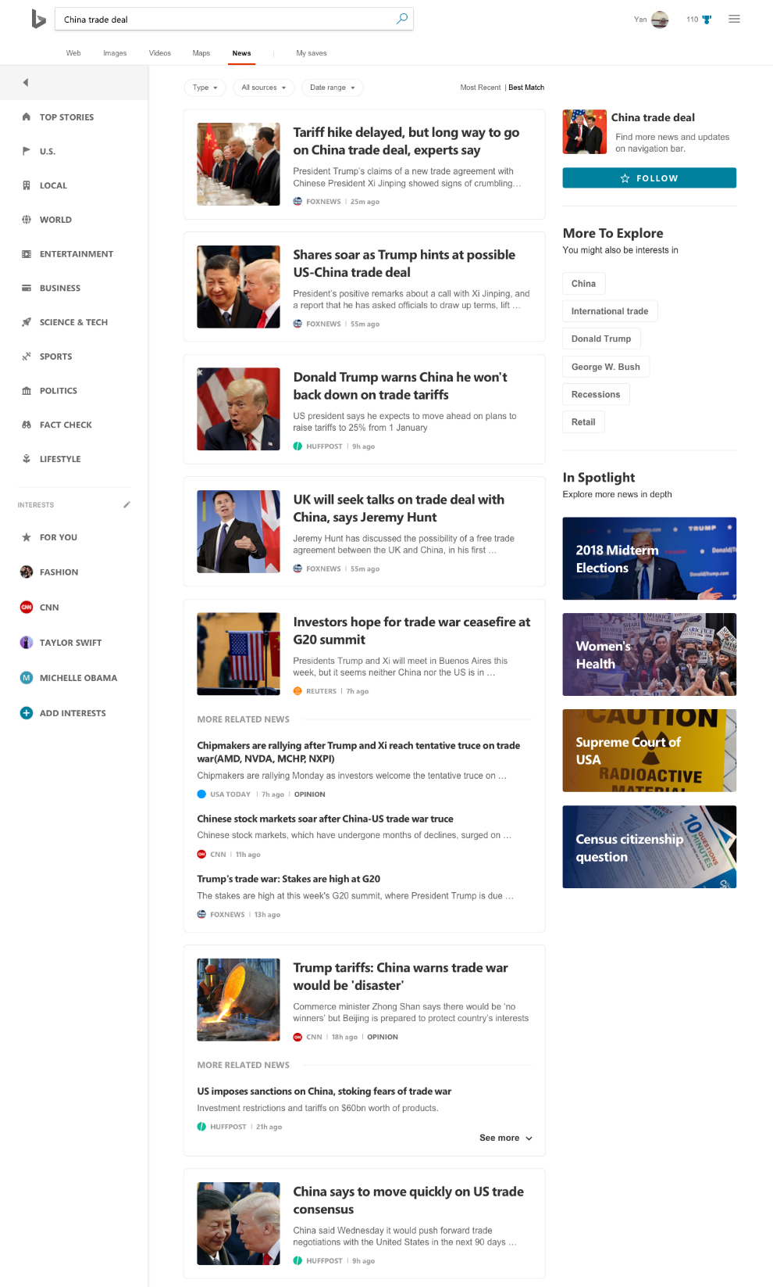
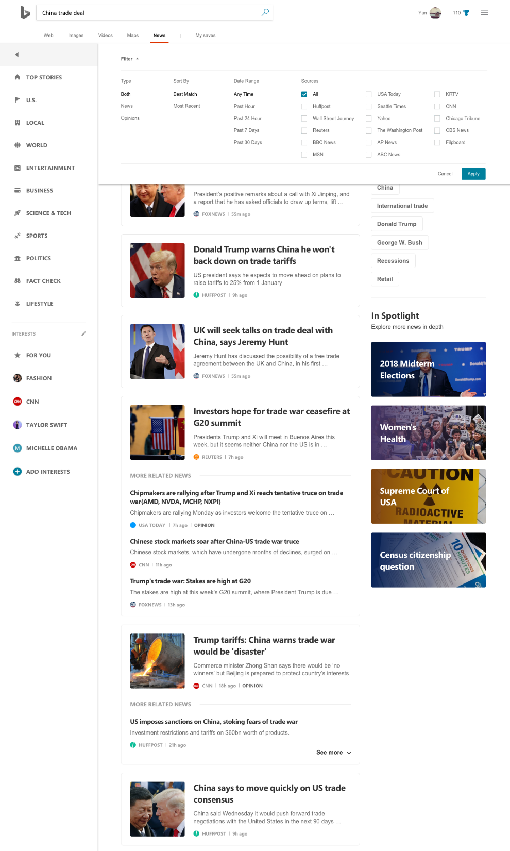
Key Findings
People preferred filter options that stood out on the page and that were positioned at the top of the results.
People overwhelmingly preferred the dropdown options to the horizonal filters in the current version.
People were split on whether they wanted separate filters for each category or an all-in-one filter menu.
People felt that some of the filter titles were unclear.
People suggested adding more filters or an Advanced option.

Slide 5
Detailed Findings: Overall Design

Slide 6
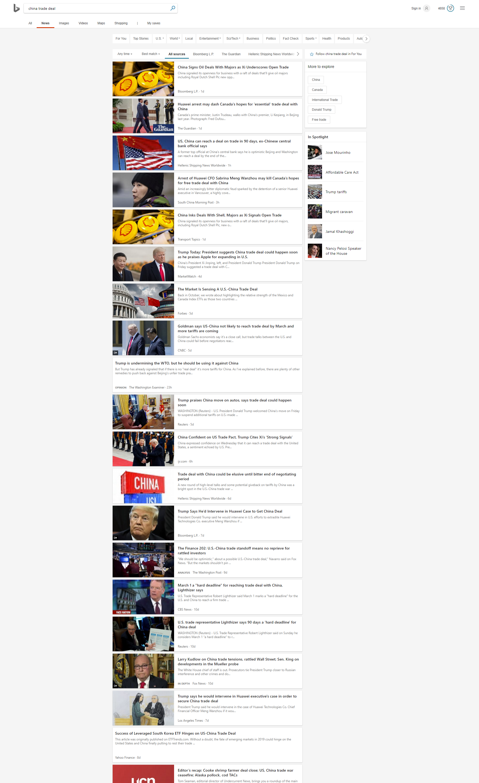

Slide 7
People found the current Bing News fine, unorganized
Participants did a search for “china trade deal” and reviewed the results on the current Bing News vertical.
In general, participants had somewhat neutral results to the Bing News results.
They felt like the sources shown were mostly reputable and that the results were relevant to the query.
People liked the filters at the top, although questioned their functionality (i.e. could they select more than one source, were there more options they couldn’t see, why did they have to scroll over to see all the options)
However, people found the results to be somewhat unorganized or couldn’t understand the ordering of the results.
They felt like the results should be in chronological order and didn’t feel like the results had any discernable order outside of that.
People also felt like the visual layout was a bit cluttered and distracting.
They liked the images next to the stories and the snippets of content, but felt that the design of the page was lacking.

Slide 8
People noticed and liked the filters, want more distinction
The filters on Bing News continue to be a positive feature, with most people saying they noticed them.
However, only 35% of participants said they regularly use filters on news results. 65% said they rarely or never use filters for these queries.
Despite liking the filters, people suggested putting the results in a better order (i.e. most recent first) to allow them to filter by other factors instead of having to take this step.
Some people felt that the filters blended in to the category headers, and suggested ways to make them stand out more.
People also expressed concern about how many filters they could select at once and felt that there was too much horizonal scrolling involved in the process.

Slide 9

After review, people found Bing News fine, but could improve
After reviewing the Bing News results and exploring the page, participants reiterated that the overall design was fine but could be improved.
The biggest improvement requested was the reordering of the results to show most recent first.
People also felt that it was jarring when results didn’t have an image associated with them.
They found this to interrupt their scanning of the results and suggested putting something in place of the image to improve the visual flow.
Other suggested improvements included:
Removing the opinion section in the middle of the page and/or adding a filter to sort/remove opinion content
Creating more visual separate between the category menu and the filters
Removing the features on the right side or explaining what they are
Adding an option to filter results by geography
Improving the look of the More to Explore feature

Slide 10
“Gosh, it’s so much better!”
“This could be a game changer for a lifelong Google user.”
“It is a massive improvement.”
“This is a complete, better upgrade.”

Slide 11
People preferred the new design overall
Participants were directed to the prototype to review the new Bing News design, again using search results for “china trade deal.”
People overwhelmingly preferred the new design, saying it was better organized and more visually appealing.
People said the new design looked “more professional and trustworthy,” “beautiful,” “modern,” “clean,” “brighter,” and “less cluttered.”
People also felt that the results were more organized, which made it easier for them to scan the results and feel informed.
The boxes around the stories also contributed to the feedback that the page felt more organized, as did seeing the logos of the sources within the results.
People especially liked that the category navigation was moved to the left side of the page, creating better distinction from the filters and making both easier to use.
People felt like the filter design was cleaner and easier to use.
They also liked that the left-side navigation was easier to use and felt more modern.
People also felt that they noticed more of the features on the right-side of the page (that many had missed in the current design.)
They especially liked the design of the Spotlight feature and the visual appeal of using the images.
People also liked that the right-side features had additional text to explain what they are, which helped people understand how to engage with them.

Slide 12
People offered few suggestions to improve the new design
When asked for ways to improve the new design, 55% of participants said they couldn’t think of anything they would change.
Other participants felt that the three columns were a bit cluttered, and suggested removing the right rail completely.
They also reiterated the suggestion from the current design that the results be automatically sorted by most recent.
Some people felt there were inconsistencies in the design (like font differences and colors) that were a bit distracting.

Slide 13
People prefer the category navigation on the left side
People overwhelmingly preferred the category navigation on the left side of the page.
They felt it was easier to see, less distracting, looked nicer, and was separate from the filters.
Only one person preferred it on the top of the results, saying it felt more familiar and useful in that placement.

Slide 14
People like idea of Interests, not sure would use realistically
Most people noticed the Interests section on the page and had positive feedback about the feature.
People liked the concept of seeing personalized content, although they questioned how the feature worked. They weren’t sure if they had to actively choose their interests or if they were based on search history.
A few people compared this to features in Apple News and Google News.
Some people felt that the feature was hard to see and would be easy to skip over.
A few people also mentioned that it should be higher on the page, as personalized content would be more important than the category navigation.
Despite having mostly positive reactions to the feature, participants were split on whether they would engage with the feature realistically.
Those who said they would liked the idea of personalized topics/interests and felt that it would save them time.
Those who said they wouldn’t said they have other ways of seeing personalized content, didn’t want a search engine suggesting content to them, and that this feature felt like work for the user.
People also found For You confusing, and while they said it fit well under Interests, indicated that they likely wouldn’t use it or were indifferent to the feature.

Slide 15
People weren’t sure what Follow does, somewhat interested in feature
People weren’t sure what would happen if they clicked on the “follow” feature.
Given that confusing, only slightly more than half of participants said they would want to use it, and they added a few caveats to that usage.
They said they would be interested in using the feature for relevant topics or things that would change often, but that they were worried about the frequency of updates.
Those who weren’t interested in the feature said they didn’t want this type of experience from a search engine and were worried about it being overwhelming.

Slide 16
People found right rail features somewhat useful
Participants were asked to review the various features on the right side of the page and provide feedback on their design and usefulness.
For both features, people liked that there was text added to the features to explain what they were, which was helpful compared to the current design.
People found “More to Explore” somewhat useful.
They thought it was most useful for complex stories where they would want to explore related topics.
Some people felt that the suggested topics weren’t related to the query they were looking at and worried about it not being relevant.
People also suggested an option to minimize the feature.
People found the “Spotlight” feature well-designed and understood the concept.
They liked the idea of being able to see big news stories in greater detail, although some people felt that it was a bit irrelevant to show this on the search results for a specific story unless it showed related topics.
People weren’t clear on what to expect if they clicked on a Spotlight, with most people thinking they would see search results and not a specific feature.

Slide 17
People preferred the new filters, would use them
People preferred the new design of the filters to the current experience.
People felt that the filters stood out more, given that the category navigation was moved to the left side.
They felt that it was easier to see them and easier to engage with them.
People also felt that the design of the filters was cleaner and more modern.
They liked that the chosen filter was highlighted to help with navigation.
However, people felt that the bubbles were a bit cluttered and didn’t like having to scroll horizontally to see all of the sources.
They suggested shifting to a dropdown option to make the filters more user-friendly.

Slide 18
Detailed Findings: Filter Design

Slide 19
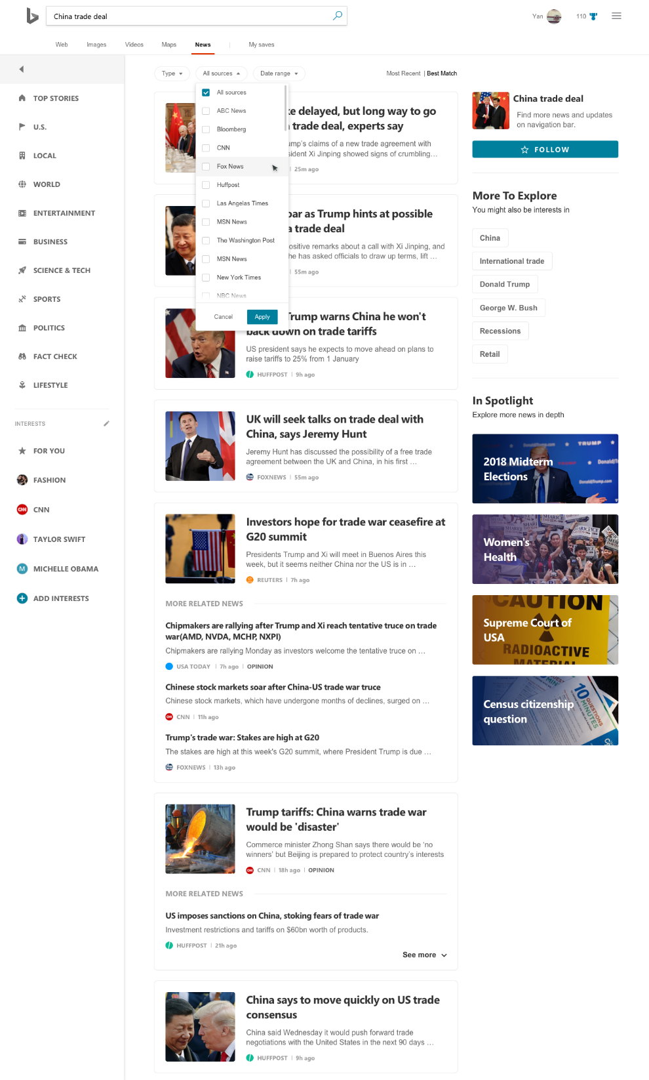
Option 1

Slide 20
Option 1: Feedback
People liked that the filters in Option 1 featured dropdown menus, which seemed more user-friendly than the current or new designs they had previously seen.
People felt that the design of the filters was less cluttered and easier to use.
Some people liked that the filters were separated by category, while others felt that it would be better to put them all in one dropdown menu to save time and effort.
People were very confused by the “Type” filter, even after seeing it expanded.
They didn’t know what “Type” meant and after seeing the options for “news” and “opinions,” still didn’t feel that it was clear.
People suggested changing “All Sources” to just “Sources” to help clarify that filter as well.
People also suggested adding more filter options or an “Advanced” option.

Slide 21

Option 2

Slide 22
Option 2: Feedback
People had mixed reactions to Option 2.
Half of the people in the study felt that this solved their request for one condensed dropdown menu that housed all of the filters in one place.
They liked only having to click once to see all of the filter options and felt that it saved them time.
The other half of the people in the study felt that it was overwhelming to have all of the options in one menu.
They preferred an option like Option 1 where they could choose each filter category separately.
Almost all participants agreed that just showing the word “Filter” was confusing and not useful.
They wanted to see something that stood out more on the page, as this design was too easy to overlook.
They also wanted something more descriptive than just “Filter” to help set expectations about what the tool does.

Slide 23
People were split on their preference for filter grouping
People who preferred to have separate filters felt that it wasn’t as overwhelming and was easier to see/use the filters.
People who preferred the condensed filters liked seeing everything at once and felt that this design saved them time and gave them more control.

Slide 24
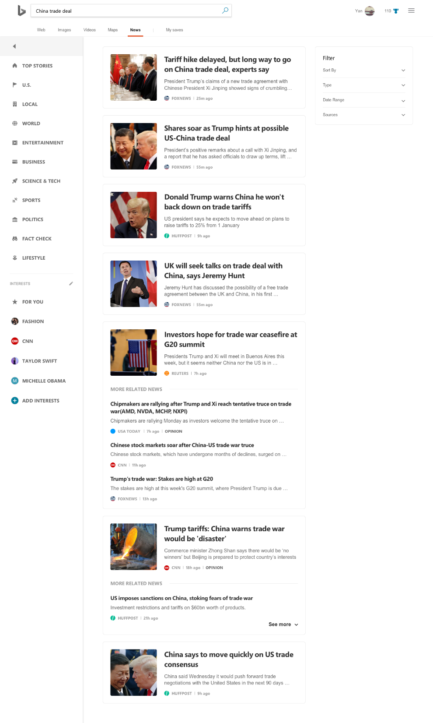
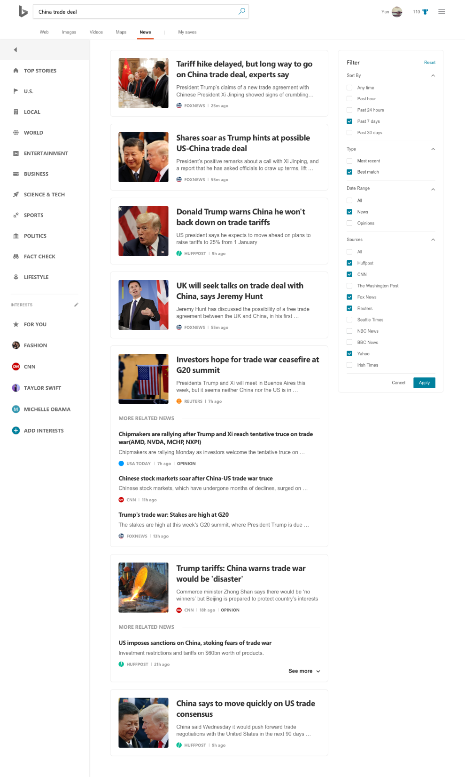
Option 3

Slide 25
Option 3: Feedback
People generally didn’t like having the filters on the side of the page, as it felt unfamiliar and cluttered.
Many people said they likely wouldn’t notice the filters on the right side of the page.
Some people said they thought this design made the filters look like an ad.
People also didn’t like all of the white space below the filters, especially when they were minimized.
A few people liked the filters on the right, saying it was a better use of space and minimized clutter.
Much like in the previous options, people were split on whether they liked having all of the filters in one menu or if they preferred separate filter options.
Most people agreed that this felt organized, but some people felt it was overwhelming to see so many filters at once.

Slide 26
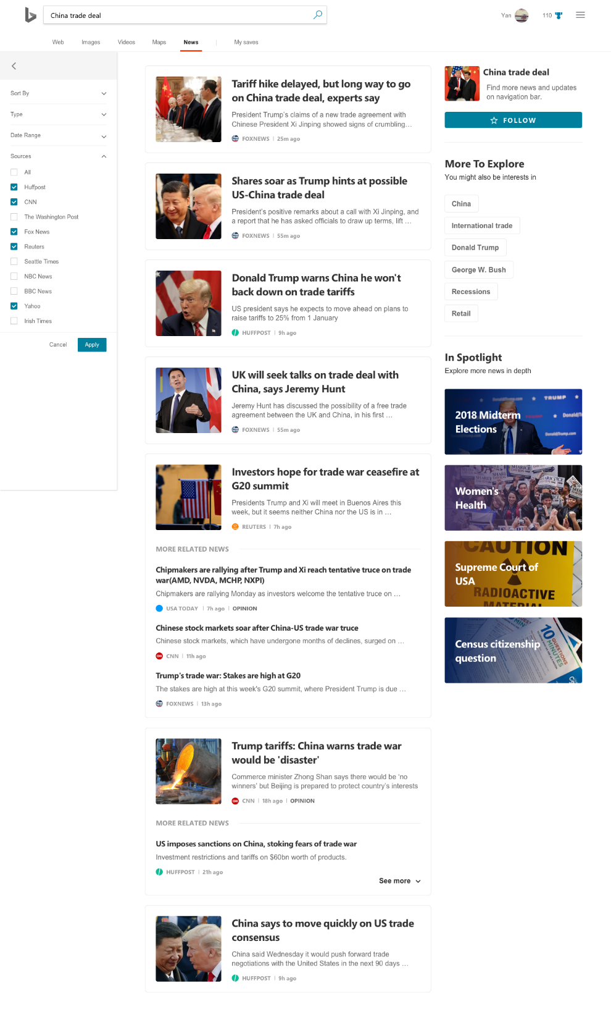

Option 4

Slide 27
Option 4: Feedback
People overwhelmingly didn’t like Option 4.
Most people said they wouldn’t even notice it on the page (and some didn’t see it until prompted by the study).
90% of participants said they would not have seen this filter option outside of the study.
People found it confusing to put the filters above the category navigation.
This was especially true when the filters were expanded, as people did not like the overlay on the category navigation.
A few people felt that this design felt more retail-oriented and made them not want to engage with it.

